Slide 1
AI Chatbot
A Comprehensive Overview of the Features and Functionalities

Slide 2
Introduction
This presentation provides an in-depth overview of the AI Chatbot website, highlighting its key components, including the homepage, tutorials, projects, and additional features.

Slide 3
01
Homepage

Slide 4
Welcome Banner and Site Description
The homepage features a prominent welcome banner that introduces users to the AI Chatbot platform. It provides a brief yet informative description that highlights the purpose of the site, guiding newcomers towards utilizing the educational resources effectively.

Slide 5
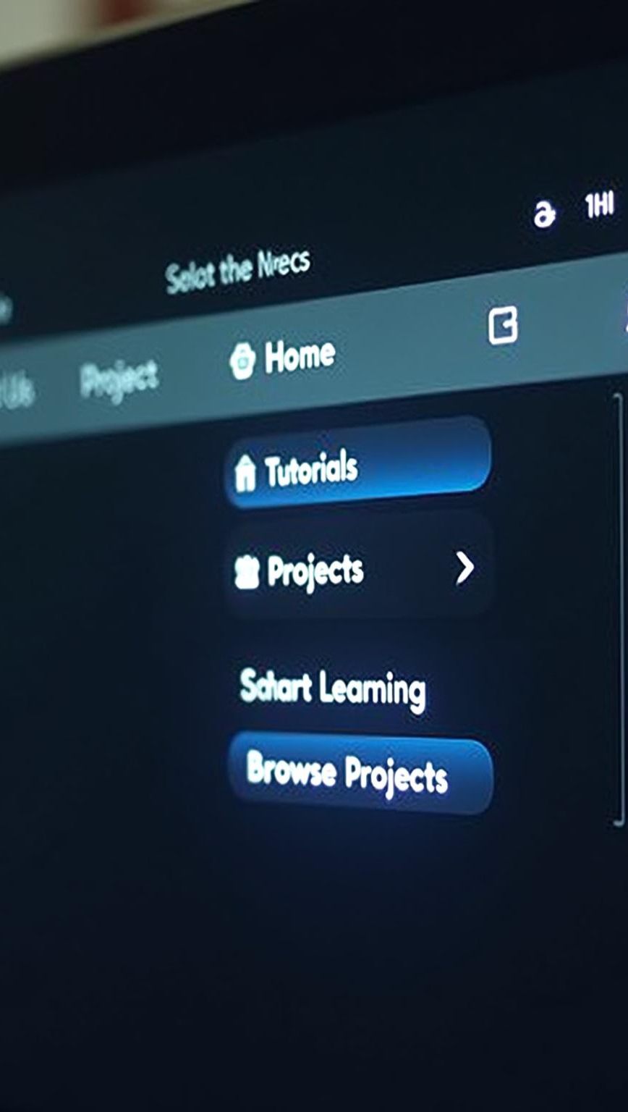
Navigation Bar Overview
The navigation bar is designed for easy access, comprising buttons for Home, Tutorials, Projects, About Us, and Contact. Additionally, a search bar facilitates quick navigation for users looking to find specific tutorials or projects. Call-to-action buttons such as 'Start Learning' and 'Browse Projects' are strategically placed to enhance user engagement.

Slide 6
Featured Tutorials Slider
The Featured Tutorials Slider showcases popular and newly added tutorials, allowing users to quickly find trending content. It rotates dynamically, ensuring that the most pertinent tutorials are highlighted prominently to capture user interest and facilitate learning.

Slide 7
02
Tutorials & Projects

Slide 8
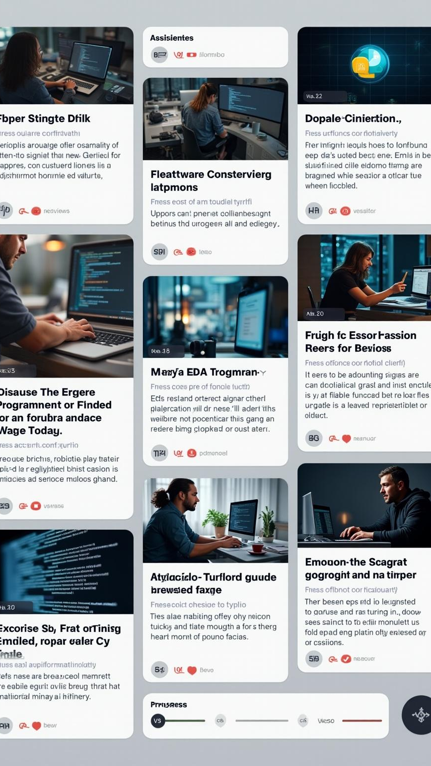
Tutorial Topics & Filters
The Tutorials section offers a diverse range of topics categorized by programming language such as Java, Python, and C++. Each tutorial is presented with a title, a concise description, and a difficulty level, allowing users to filter options based on their preferences. Additionally, a progress tracker helps users monitor their learning journey and completed lessons.

Slide 9
Project Categories & Details
Projects are organized by difficulty levels: Beginner, Intermediate, and Advanced. Each project card includes a brief description, estimated completion time, and a 'View Details' button leading to comprehensive instructions and code samples. An interactive 'Try Online' feature enables users to experiment with project code in a live editor.

Slide 10
User Account Features
User accounts provide enhanced functionality, allowing individuals to sign up or log in to access personalized dashboards. The dashboard displays tutorial progress, saved projects, and notifications related to their activity. Users can customize their profiles to improve their learning experience.

Slide 11
Conclusions
The AI Chatbot platform serves as an essential resource for learners in programming. Its well-structured homepage, diverse tutorials, and engaging projects cater to users of various skill levels while the user account features ensure a tailored educational experience.

Slide 12
Thank you!
Do you have any questions?
+00 000 000 000

